Slide 1
Software process models - 2

Slide 2
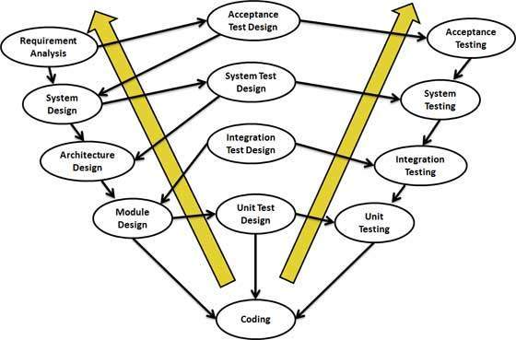
V-Model

Slide 3
V-Model
Click here to watch the video on V-Model.
It is a verification and validation model.
Extension of the classical Waterfall model.
SDCL comes with testing in every stage.
SRS, system design, architectural design, module design
– Verification Phase
Unit testing, integration, system, and acceptance testing –
Validation Phase

Slide 4
V-Model
V Model is an enhanced version of the classic waterfall model whereby each level of the development life-cycle is verified before moving on to the next level.
With this model, software testing explicitly starts at the very beginning, i.e., as soon as the requirements are written.
The left side of the "V" represents the decomposition of requirements and creation of system specifications
The right side of the V represents the integration of parts and their validation

Slide 5
V-Model
"Validation. The assurance that a product, service, or system meets the needs of the customer and other identified stakeholders. It often involves acceptance and suitability with external customers. Contrast with verification.“
"Verification. The evaluation of whether or not a product, service, or system complies with a regulation, requirement, specification, or imposed condition. It is often an internal process. Contrast with validation."
It is sometimes said that validation can be expressed by the query "Are you building the right thing?" and verification by "Are you building it right?"

Slide 6
Verification Phases
Business Requirement Analysis:
This phase involves detailed communication with the customer to understand his expectations and exact requirement.
This is a very important activity and need to be managed well, as most of the customers are not sure about what exactly they need.
The acceptance test design planning is done at this stage as business requirements can be used as an input for acceptance testing.

Slide 7
Verification Phases
System Design:
System design would comprise of understanding and detailing the complete hardware and communication setup for the product under development.
May also include planning the interaction with external systems.
System test plan is developed based on the system design.
Doing this at an earlier stage leaves more time for actual test execution later.

Slide 8
Verification Phases
Architectural Design:
Usually more than one technical approach is proposed and based on the technical and financial feasibility the final decision is taken.
System design is broken down further into modules taking up different functionality. This is also referred to as High Level Design (HLD).
The data transfer and communication between the internal modules and with the outside world (other systems) is clearly understood and defined
With this information, integration tests can be designed and documented during this stage.

Slide 9
Verification Phases
Module Design:
The detailed internal design for all the system modules is specified, referred to as Low Level Design (LLD).
It is important that the design is compatible with the other modules in the system architecture and the other external systems.
Unit tests can be designed at this stage based on the internal module designs.
Unit tests are an essential part of any development process and helps eliminate the maximum faults and errors at a very early stage.

Slide 10
Validation Phases
Unit Testing:
Unit tests designed in the module design phase are executed on the code during this validation phase.
Unit testing is the testing at code level and helps eliminate bugs at an early stage
Though all defects cannot be uncovered by unit testing.

Slide 11
Validation Phases
Integration Testing:
Integration testing is associated with the architectural design phase.
Integration tests are performed to test the coexistence and communication of the internal modules within the system.
System Testing:
System testing is directly associated with the System design phase.
System tests check the entire system functionality and the communication of the system under development with external systems.
Most of the software and hardware compatibility issues can be uncovered during system test execution.

Slide 12
Validation Phases
Acceptance Testing:
Acceptance testing is associated with the business requirement analysis phase and involves testing the product in user environment.
Acceptance tests uncover the compatibility issues with the other systems available in the user environment.
It also discovers the nonfunctional issues such as load and performance defects in the actual user environment.

Slide 13
V-Model-Advantages
In V Model, each phase has specific deliverables.
Higher chance of success over the waterfall model due to the development of test plans early on during the life cycle.
Time concern in comparison with the waterfall model is low or even we can say 50% less.
Works well for small projects where requirements are easily understood.
Utility of the resources is high
Notes:
13

Slide 14
V Model-Limitations
Very rigid, like the waterfall model.
Little flexibility and adjusting scope is difficult and expensive.
Software is developed during the implementation phase, so no early prototypes of the software are produced.

Slide 15
Incremental process model

Slide 16
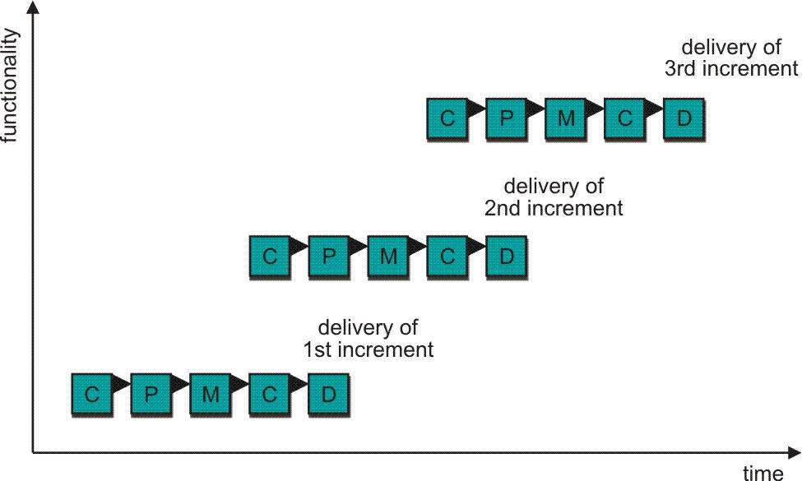
Incremental Process Model
Module-by-module development
C - Communication
P - Planning
M – Modeling
C - Construction
D - Deployment

Slide 17
Incremental Process Model
Click here to watch the video on Incremental Process Model.
Requirements
Design and development
Implementation
Testing
module 1
module 2, module 3, module 4…..will follow the same process
A
A
B
A
B
C
………………………………………
Ex: Portal (LMS), product-based company, mobile app (regular update)

Slide 18
Incremental Process Model
Rather than deliver the system as a single delivery, the development and delivery is broken down into increments with each increment delivering part of the required functionality.
First Increment is often core product
Includes basic requirement
Many supplementary features (known & unknown) remain undelivered

Slide 19
Incremental Process Model
A plan of next increment is prepared
Modifications of the first increment
Additional features of the first increment
It is particularly useful when enough staffing is not available for the whole project
Incremental model focus more on delivery of operation product with each increment.

Slide 20
Incremental Model-Applications
Major requirements must be defined; however, some functionalities or requested enhancements may evolve with time.
If a new technology has to be used, it can be learnt by the development team while working on the project.
If resources with needed skill set are not available, then appropriate recourse person can be planned to be used on contract basis for specific iterations.

Slide 21
Incremental Process Model-Benefits
The cost of accommodating changing customer requirements is reduced.
Finding issues at an early stage of development enables to take corrective measures in a limited budget.
The amount of analysis and documentation that has to be redone is much less than is required with the waterfall model.

Slide 22
Incremental Process Model-Benefits
It is easier to get customer feedback on the development work that has been done.
Customers can comment on demonstrations of the software and see how much has been implemented.
More rapid delivery and deployment of useful software to the customer is possible.
Customers are able to use and gain value from the software earlier than is possible with a waterfall process.

Slide 23
Incremental Process Model-Limitations
Problems might cause due to system architecture as such not all requirements collected up front for the entire software lifecycle
Rectifying a problem in one unit requires correction in all the units and consumes a lot of time
System structure tends to degrade as new increments are added.
Unless time and money is spent on refactoring to improve the software, regular change tends to corrupt its structure. Incorporating further software changes becomes increasingly difficult and costly.

Slide 24
Evolutionary process models

Slide 25
Evolutionary Process Models
Produce an increasingly more complete version of the software with each iteration.
Evolutionary Models are iterative.
Evolutionary models are:
Prototyping
Spiral Model

Slide 26
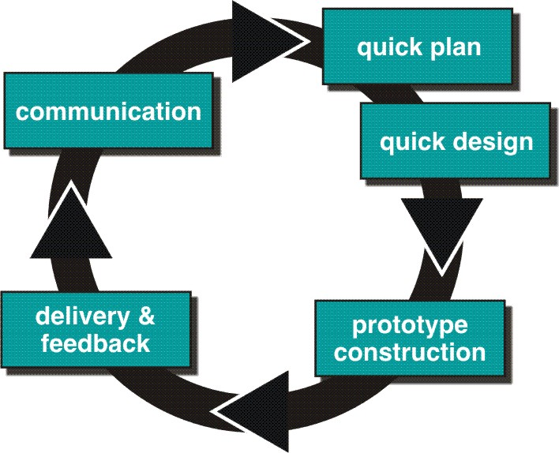
Evolutionary Process Models

Slide 27
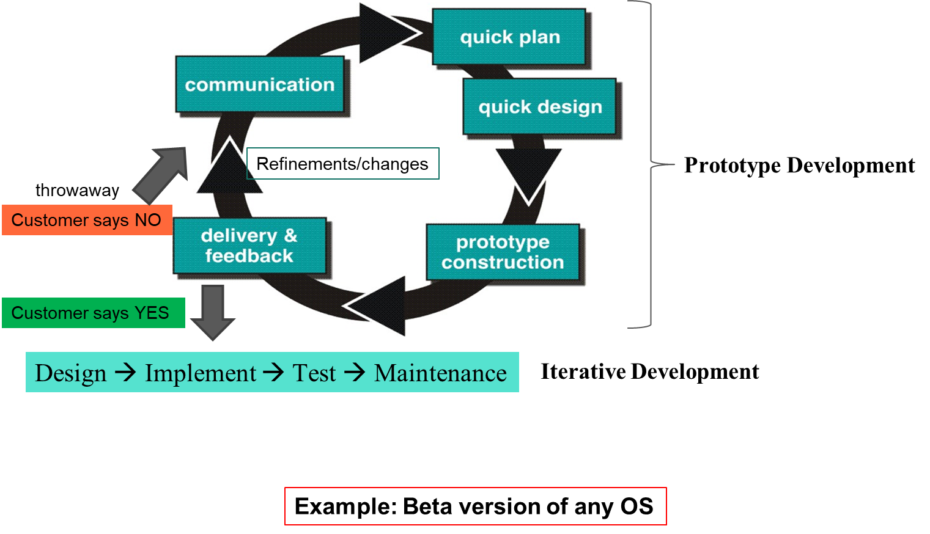
Prototype Model
Click here to watch the video on Prototype Model.

Slide 28
Prototype Model
Best approach when:
Objectives defined by the customer are general but do not have details like input, processing, or output requirement.
Developers may be unsure of the efficiency of an algorithm, O.S., or the form that human-machine interaction should take.
It can be used as a standalone process model.
Model assists software engineer and customer to better understand what is to be built when the requirement is fuzzy.

Slide 29
Prototype Model
Prototyping start with communication, between a customer and software engineer to define overall objective, identify requirements and make a boundary.
Going ahead, planned quickly and modeling (software layout visible to the customers/end-user) occurs

Slide 30
Prototype Model
Quick design leads to prototype construction.
Prototype is deployed and evaluated by the customer/user.
Feedback from the customer/end user will refine requirements and that is how iteration occurs during the prototype to satisfy the needs of the customer.
Prototype can serve as “the first system”.
Both customers and developers like the prototyping paradigm.
Customer/End user gets a feel for the actual system
Developers get to build something immediately.

Slide 31
Types of prototyping- Throwaway prototyping
Also called close-ended prototyping. Throwaway or Rapid Prototyping refers to the creation of a model that will eventually be discarded rather than becoming part of the final delivered software
The most obvious reason for using Throwaway Prototyping is that it can be done quickly
Another strength of Throwaway Prototyping is its ability to construct interfaces that the users can test.

Slide 32
Types of prototyping- Throwaway prototyping
In this approach, the prototype is constructed with the idea that it will be discarded, and the final system will be built from scratch. The steps in this approach are:
Write preliminary requirements
Design the prototype
User experiences/uses the prototype, specifies new requirements
Repeat if necessary
Write the final requirements

Slide 33
Types of prototyping- Evolutionary Prototyping
Evolutionary Prototyping is quite different from Throwaway Prototyping.
The main goal when using Evolutionary Prototyping is to build a very robust prototype in a structured manner and constantly refine it.
The reason for this is that the Evolutionary prototype, when built, forms the heart of the new system, and the improvements and further requirements will be built.
When developing a system using Evolutionary Prototyping, the system is continually refined and rebuilt.
"…evolutionary prototyping acknowledges that we do not understand all the requirements and builds only those that are well understood”

Slide 34
Software Prototyping Application
Software Prototyping is most useful in the development of systems having a high level of user interactions such as online systems. Systems that need users to fill out forms or go through various screens before data is processed can use prototyping very effectively to give the exact look and feel even before the actual software is developed.
Software that involves too much of data processing and most of the functionality is internal with very little user interface does not usually benefit from prototyping. Prototype development could be an extra overhead in such projects and may need a lot of extra effort.

Slide 35
Prototyping-Advantages
The software designer and implementer can obtain feedback from the users early in the project.
The client and the contractor could compare if the software made matches the software specification, according to which the software program is built.
It also allows the software engineer some insight into the accuracy of initial project estimates and whether the deadlines and milestones proposed can be successfully met.

Slide 36
Prototyping-Limitations
Users can begin to think that a prototype, intended to be thrown away, is actually a final system that merely needs to be finished or polished.
Developers can also become attached to prototypes they have spent a great deal of effort producing; this can lead to problems like attempting to convert a limited prototype into a final system when it does not have an appropriate underlying architecture.
Developer often makes implementation in order to get a prototype working quickly without considering other factors in mind like OS, Programming language, etc.

Slide 37
Spiral Model
It provides the potential for rapid development of an increasingly more complete version of the software.
Using spiral, software developed in a series of evolutionary releases.
Early iteration, the release might be on paper or prototype.
Later iteration, a more complete version of the software.
Divided into framework activities (C,P,M,C,D). Each activity represents one segment.
Evolutionary process begins in a clockwise direction, beginning at the center risk.

Slide 38
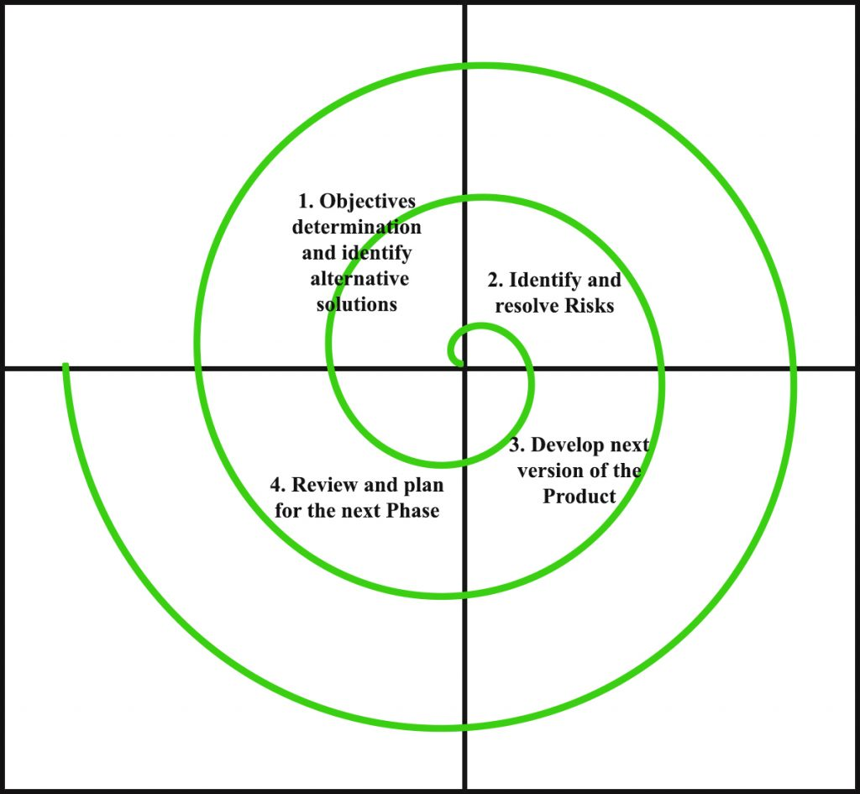
Spiral Model
Risk handling
The radius of the Spiral = Cost
Angular Dimension = progress
Meta Model (follows multiple
models)
Project team must be expert
in risk analysis.
Large projects
Loop runs until the project manager
/customer is satisfied.
NASA, defense project etc.
prototype

Slide 39
Spiral Model
Click here to watch the video on Spiral Model.
Click here to watch the video on Spiral Model.
Click here to watch the video on Spiral Model.
Both short and long-term software projects with associated risks

Slide 40
Spiral Model
Identification
business requirements in the baseline spiral.
In the subsequent spirals as the product matures, identification of system requirements, subsystem requirements and unit requirements are all done in this phase.
This also includes understanding the system requirements by continuous communication between the customer and the system analyst.
At the end of the spiral the product is deployed in the identified market.

Slide 41
Spiral Model
Design:
It starts with the conceptual design in the baseline spiral and involves the following designs in the subsequent spirals.
architectural design,
logical design of modules,
physical product design
final design

Slide 42
Spiral Model
Construct or Build
Production of the actual software product at every spiral.
In the baseline spiral when the product is just thought of and the design is being developed a POC (Proof of Concept) is developed to get customer feedback.
In the subsequent spirals with higher clarity on requirements and design details a working model of the software called build is produced with a version number.
These builds are sent to customer for feedback.

Slide 43
Spiral Model
Evaluation and Risk Analysis:
Risk Analysis includes identifying, estimating, and monitoring technical feasibility and management risks, such as schedule slippage and cost overrun.

Slide 44
Spiral Model Applications
It is in synch with the natural development process of any product i.e.
learning with maturity and involves minimum risk for the customer as well as the development firms.
Following are the typical uses of Spiral model:
When costs there is a budget constraint.
For medium to high-risk projects.

Slide 45
Spiral Model Applications
Long-term project commitment because of potential changes to economic priorities as the requirements change with time.
Customer is not sure of their requirements which is usually the case.
Requirements are complex and need evaluation to get clarity.
New product line which should be released in phases to get enough customer feedback.
Significant changes are expected in the product during the development cycle.

Slide 46
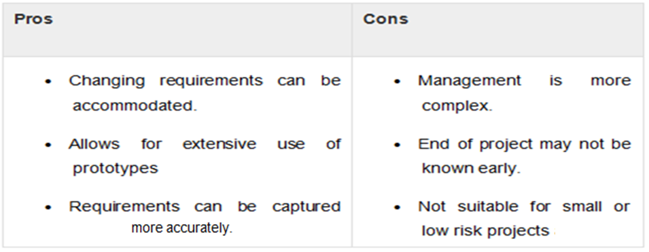
Spiral Model

Slide 47
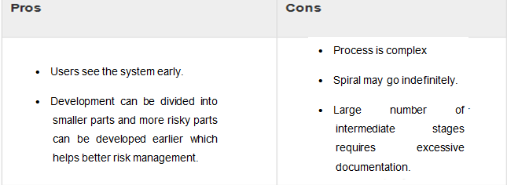
Spiral Model

Slide 48
Classwork

Slide 49
Classwork
Instructions -
For the following questions, you are allowed to use the lecture slides, notes, any books and even the internet.
But you are not allowed to directly copy/paste from anywhere. Except, of course, standard definitions and/or quotations. This means you have to understand the points and write them in your own words. Type your answers and submit.
I will be running each answer through plagiarism checkers. Plagiarism will lead to a big zero. But everything should be fine as long as you use your own words for answers.
Each answer should be in 200 words or less. You should include sufficient descriptions and / or explanations and examples in your answer.

Slide 50
Classwork
Briefly describe the V model in your own words.
In what cases do you think the V model is appropriate to apply?
What is the difference between system design and architecture design?
What the different stages of software testing? Are there other stages not discussed in the lecture? Describe each stage in your own words.
What are the differences between validation and verification?

Slide 51
Classwork
Describe the incremental process model in your own words.
Explain in what way the incremental model may be more efficient than the V model.
Explain in what way the waterfall model may be more applicable than the incremental model.
“Each stage of the incremental model is completed following the waterfall model” Do you agree or disagree? Explain your answer.

Slide 52
Classwork
Describe the evolutionary process model in your own words.
What are the differences between the incremental model and the prototyping model?
What are the differences between spiral model and incremental model?
What are the differences between between spiral model and prototyping model?
What process model would you use when the client himself is unsure of the requirements?

Slide 53
Thank you!

